Slide 1
Magic Voice App
BY
Shadi Jiha
Christina Darstbanian

Slide 2
Application: Voice Enabled App
Main Problem:
Creating an application that allows users to navigate the application, fill forms and read content via voice instructions
Objective :
Help Users navigate Easily Through Voice instructions
Let Users create posts and fill forms

Slide 3
Main Approach
User database with credentials
Access to their account after login or register
Navigation and completing many functionalities by speech recognition technology.
User friendly voice commands.

Slide 4
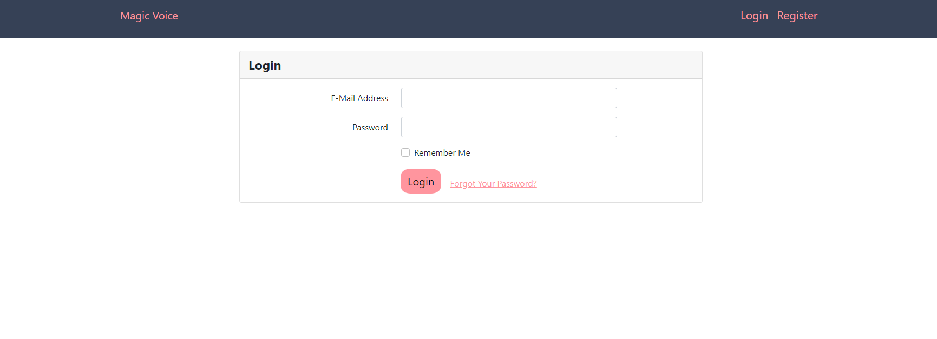
User Friendly Design
Easy Transmission between parts of the application
Error feedback

Slide 5
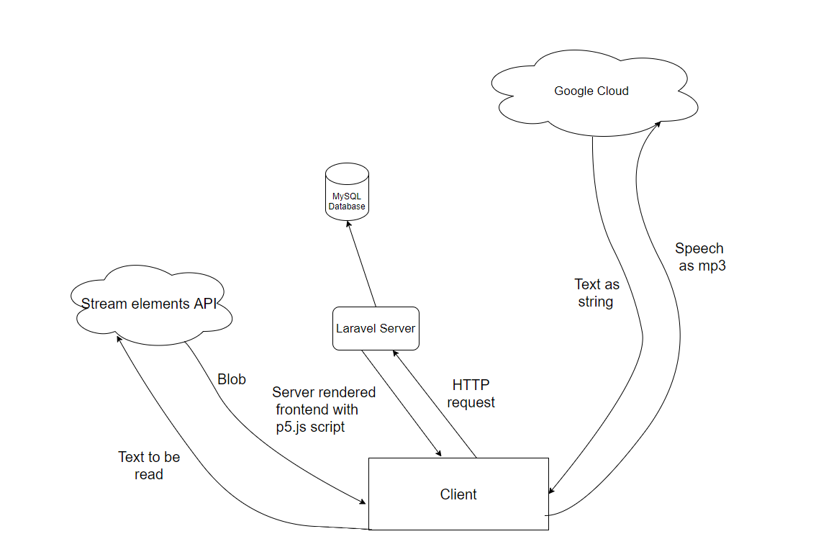
Speech recognition with P5.Js
How it works?

Slide 6
Technologies Used:
Speech recognition(P5.Js)
PHP Laravel
Composer and NPM
MySQL
Blade
JavaScript
Bootstrap

Slide 7
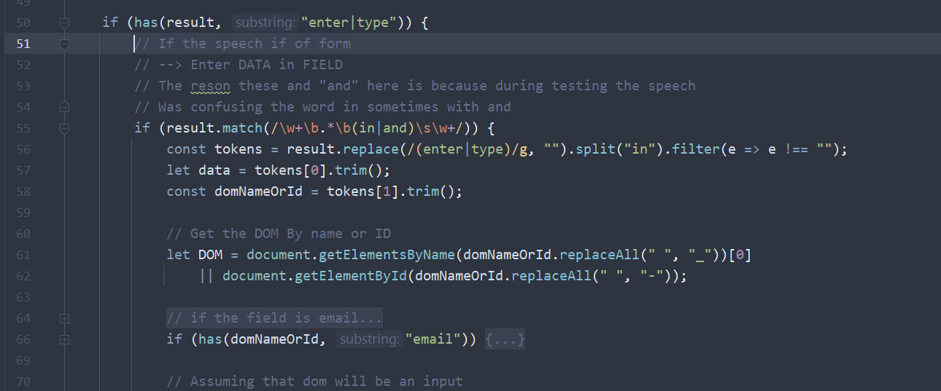
Wrong text recognition
This happens on the usage of similar pronunciation words (such as “test” and “text” ). The voice recognizer gets confused.

Slide 8

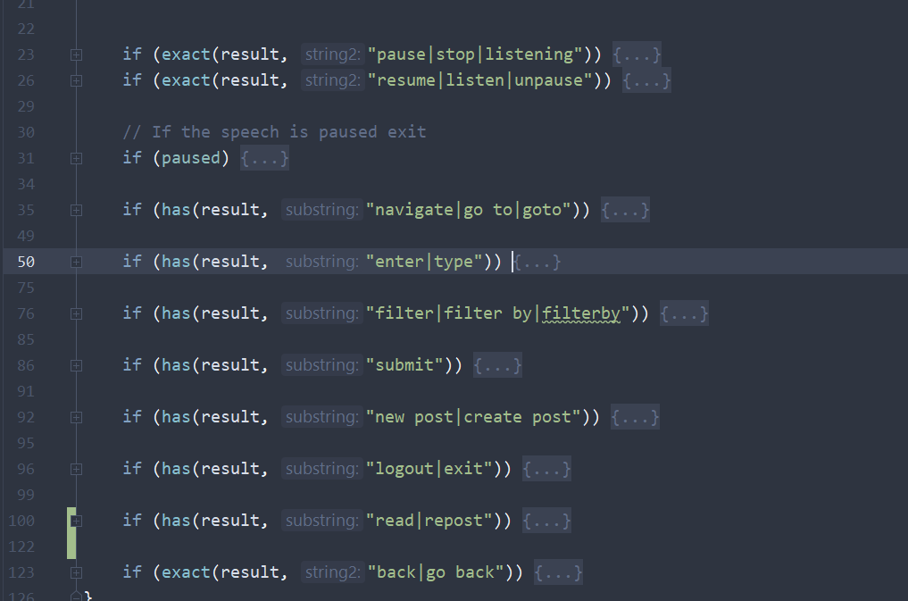
Multiple choice
Each user gives different command structure.
Solution: Added multiple choice. E.g. line 92

Slide 9
Finding the right API
Challenges encountered
Cost
Request limit
Stream elements:
Free
Enough requests per minute
Notes:
* Hard to find correct choice API for text-to-speech

Slide 10
Extendibility
Given the timeframe. Very hard for API design
The purpose was to demonstrate that voice command are possible
HOWEVER! Can refactor and use callbacks
Notes:
* it was really hard to design a full extendable and maintainable system that would work on any application.
*
* It is easy to refactor the code to use some sort of Callback system. Which allows each application to define

Slide 11
Application presentation Time!

